Slide 1

Assembly Language
Part III Program Structure and I/O Controls
Department of Computer Science, Faculty of Science, Chiang Mai University

Slide 2
Outline
Program Structure
Input-Output control and macro programming
A First Program
Displaying a String
A Case Conversion Program
Creating and Running a Program

Slide 3
Memory Models
Model Description
SMALL code in one segment
data in one segment
MEDIUM code in more than one segment
data in one segment
COMPACT code in one segment
data in more than one segment
LARGE code in more than one segment
data in more than one segment
no array larger than 64k bytes
HUGE code in more than one segment
data in more than one segment
arrays may be larger than 64k bytes

Slide 4
Data Segment
A program’s data segment contains all the variable definitions.
Constant definitions are often made here as well, but they may be placed elsewhere in the program since no memory allocation is involved.

Slide 5
Stack Segment
The purpose of the stack segment declaration is to set aside a block of memory (the stack area) to store the stack.
The stack area should be big enough to contain the stack at its maximum size.
100h bytes for the stack area is a reasonable size for most applications

Slide 6
Code Segment
The code segment contains a program’s instructions.
Inside a code segment, instructions are organized as procedures.
The last line in the program should be the END directive, followed by name of the main procedure.

Slide 7
Putting It Together
.MODEL SMALL
.STACK 100H
.DATA
; data definitions go here
.CODE
MAIN PROC
; instructions go here
MAIN ENDP
; other procedures go here
END MAIN

Slide 8
INT
I/O service routines
The Basic Input/Output System (BIOS) routines
The DOS routines
The INT (interrupt) instruction is used to invoke a DOS or BIOS routine.
INT Interrupt_number

Slide 9
INT 21h
INT 21h may be used to invoke a large number of DOS functions.
A particular function is requested by placing a function number in the AH register and invoking INT 21h.

Slide 10
Function 1: Single-Key Input
Input:
AH = 1
Output:
AL = ASCII code if character key is pressed
= 0 if non-character key is pressed

Slide 11
Function 1: Single-Key Input
MOV AH, 1 ; input key function
INT 21h ; ASCII code in AL

Slide 12
Function 2: Display a Character or Execute a Control Function
Input:
AH = 2
DL = ASCII code of the display character or
= control character
Output:
AL = ASCII code of the display character or
= control character

Slide 13
Function 2: Display a Character or Execute a Control Function
MOV AH, 2 ; display character function
MOV DL, ‘?’ ; character is ‘?’
INT 21h ; display character

Slide 14
A First Program
ECH.ASM will read a character from the keyboard and display it at the beginning of the next line.
The data segment was omitted because no variables were used.
When a program terminates, it should return control to DOS.
This can be accomplished by executing INT 21h, function 4Ch.

Slide 15
Function 9: Display a String
Input:
DX = offset address of string.
= The string must end with a ‘$’ character.

Slide 16
LEA
LEA is used to load effective address of a character string.
LEA destination, source
MSG DB ‘HELLO!$’
LEA DX, MSG ; get message
MOV AH, 9 ; display string function
INT 21h ; display string

Slide 17
A Case Conversion Program
CASE.ASM begins by prompting the user to enter a lowercase letter, and on the next line displays another message with the letter in uppercase.
The lowercase letters begin at 61h and the uppercase letters start at 41h, so subtraction of 20h from the contents of AL does the conversion.

Slide 18
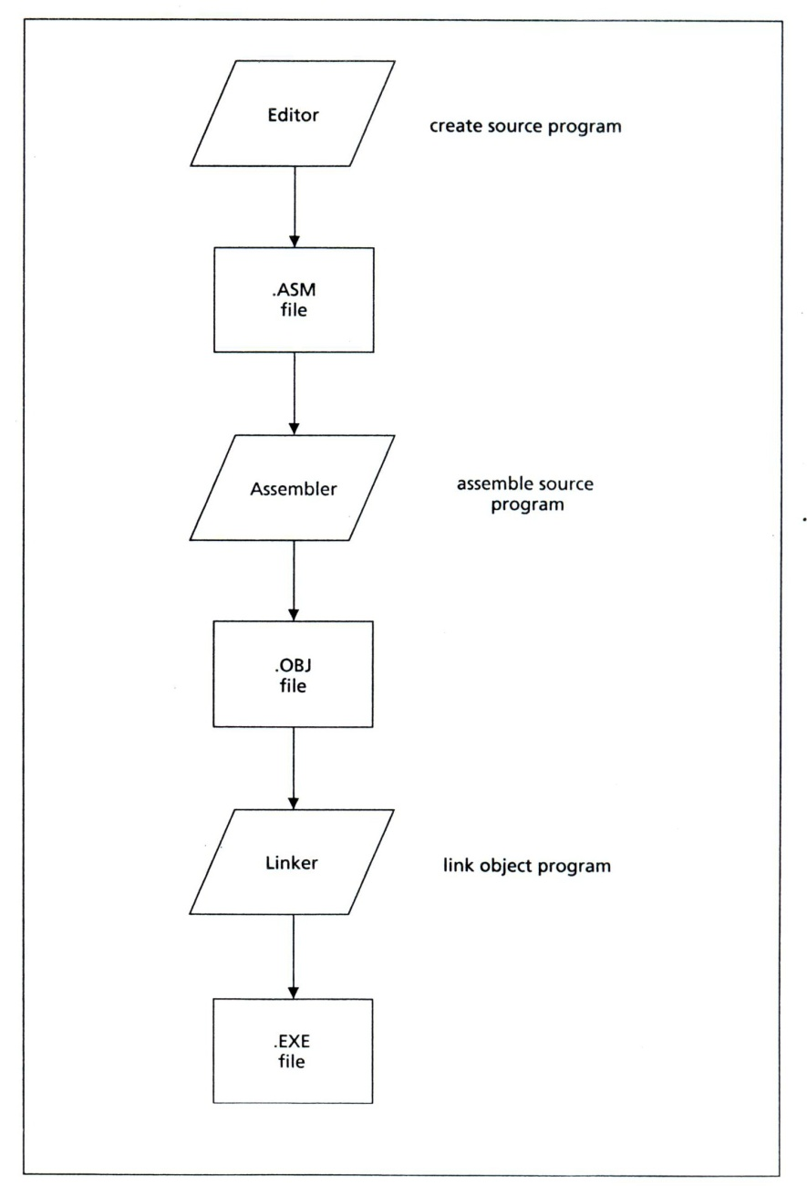
Programming Steps

Slide 19
Step 1. Create the Source Program File
An editor is used to create the preceding program.
The .ASM is the conventional extension used to identify an assembly language source file.

Slide 20
Step 2. Assemble the Program
The Microsoft Macro Assembler (MASM) is used to translate the source file (.ASM file) into a machine language object file (.OBJ file).
MASM checks the source file for syntax errors.
If it finds any, it will display the line number of each error and a short description.
C:\>MASM File_Name;

Slide 21
Step 3. Link the Program
The Link program takes one or more object files, fills in any missing addresses, and combines the object files into a single executable file (.EXE file)
This file can be loaded into memory and run.
C:\>LINK File_Name;

Slide 22
Step 4. Run the Program
To run it, just type the run file name.
C:\>File_Name

Slide 23
DOS Commands
C: go to drive C:
DIR displays the contents of a directory
CD <DIRECTORYNAME> takes you to that directory. You can use one or more subdirectory names
CD\ takes you to the top of the directory tree (typically to C:) .
CD.. moves you one level up the directory tree (i.e. up towards the root directory).

Slide 24
Reference
Ytha Yu and Charles Marut, Assembly Language Programming and Organization of the IBM PC. New York: McGraw-Hill, 1992.

